Slide 1
Human resources slide 1
G2M Case Study
Dhanashri Jagadale

Slide 2
Human resources slide 2
Hypothesis
People from particular city take more taxis
Women prefer pink taxis
Age affect the color of taxi?
People prefer yellow or pink in any specific month
Income effect the number of rides
Price affects the choice of taxis
Price charged proportionally increase with increase in number of customers

Slide 3
Human resources slide 2
Comparison of Yellow & Pink Cab
Total market profit share
Total user share
Yearly income
Number of kilometers
Cab Preference Per City

Slide 4

Human resources slide 4
Background
The XYZ company, a private holding company in the US, plans to invest in the cab industry due to its rapid growth in recent years.
Aim : To provide XYZ with actionable insights so it can select the right company for investment.

Slide 5
Human resources slide 4
Data Exploration
It is the first step in data analysis and aims to uncover insights from data by exploring and visualizing it in order to identify areas or patterns from the start of the analysis
During Data Exploration I got use the following functions
I obtained the dimensions of the specified data frame using shape function, There were 4 datasets, I merged in to one master data set, named final which had 359392 rows and 14 columns
The info() function helped me understand the data's structure of the Data Frame
I used head() function to analyze the first five rows of data.
In used tail() function to analyze the last five rows of data.
In order to find out which columns have null values, used col.isnull.sum() .

Slide 6
Human resources slide 4
Outlier Detection
In order to identify outliers in the data, I used boxplot
On further analysis on the columns Price Charged, Km_Travelled, and Cost of Trip
We found outliers in the Price Charged column

Slide 7
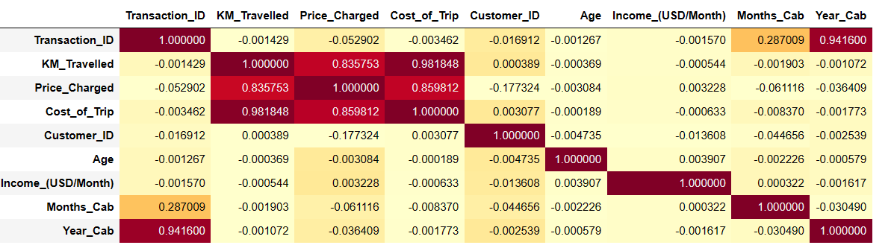
Human resources slide 4
Is there any correlation between variables
The cost of trip and price charged is highly corelated to Km_Travelled. Rest, there is no correlation present between variables

Slide 8
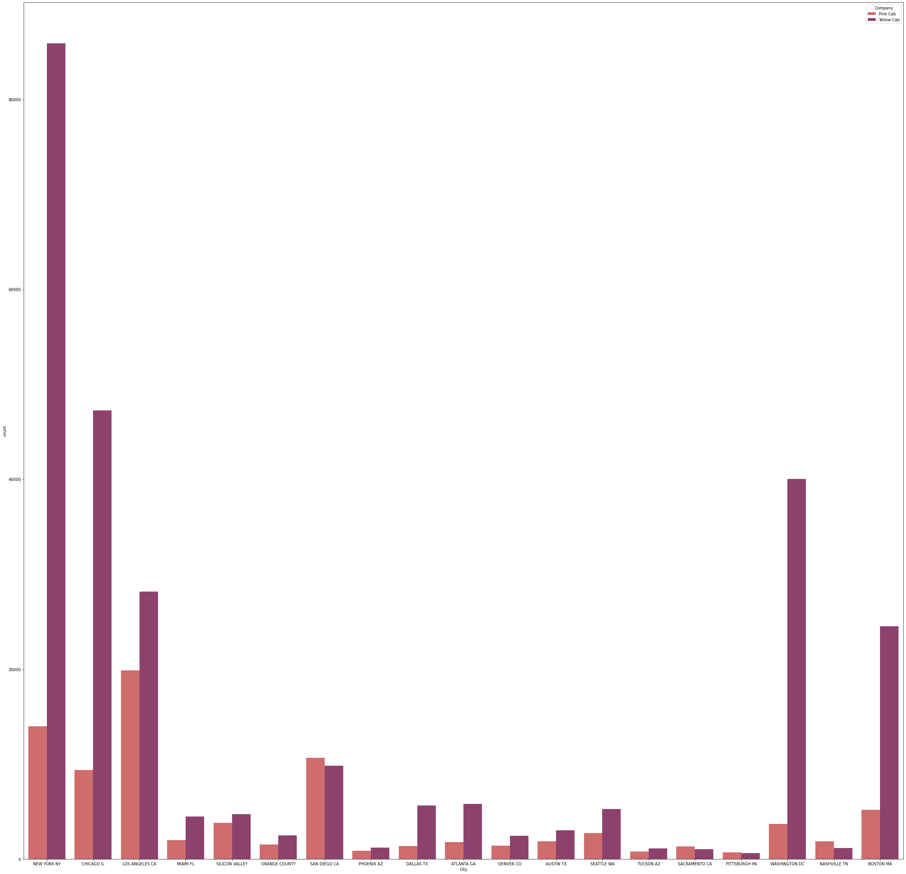
Human resources slide 4
Hypo 1: People from particular city take more taxis
People from New York city more cabs as compared to other cities

Slide 9
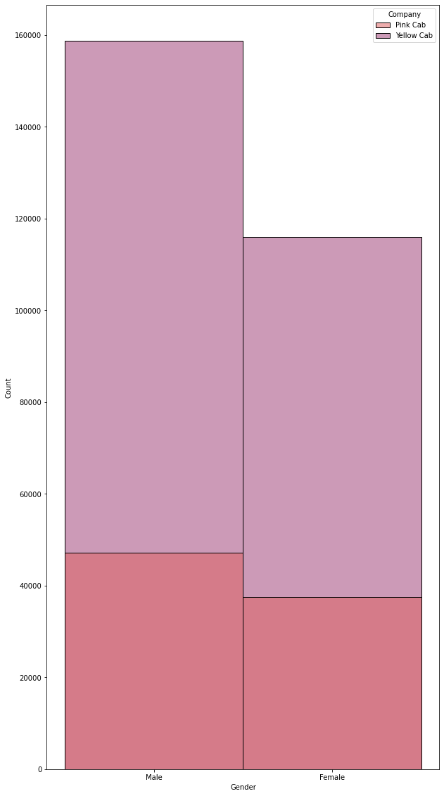
Human resources slide 4
Hypo 2: Women prefer pink taxis
There is no proof that females prefer pink taxis than yellow

Slide 10
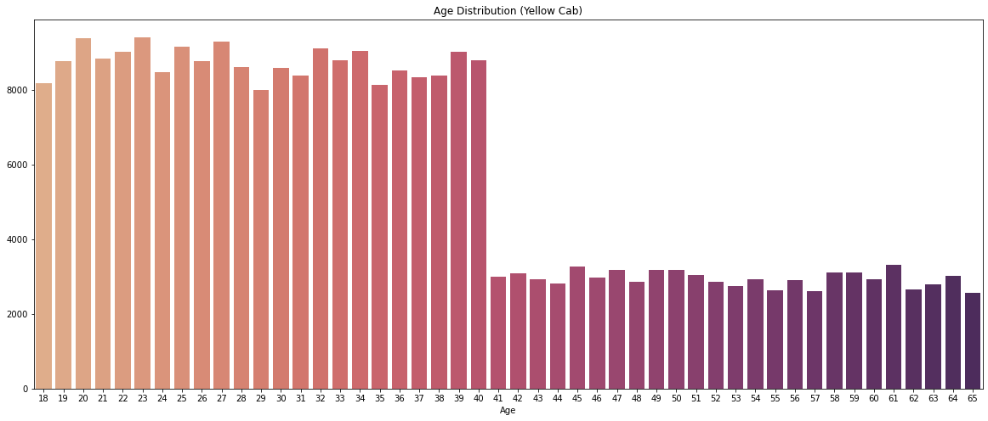
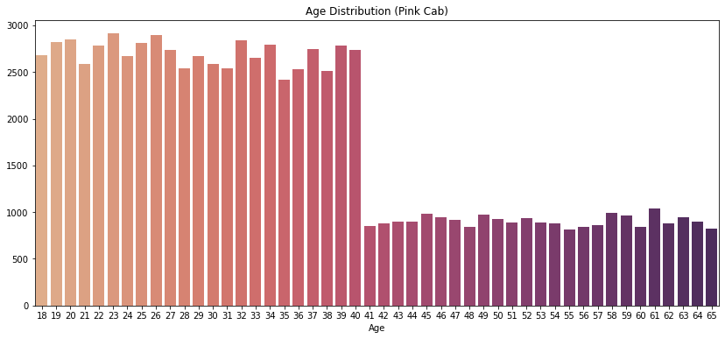
Human resources slide 4
Hypo 3: Age affect the color of taxi
People from age 18-40 prefer yellow taxis more than pink taxis

Slide 11
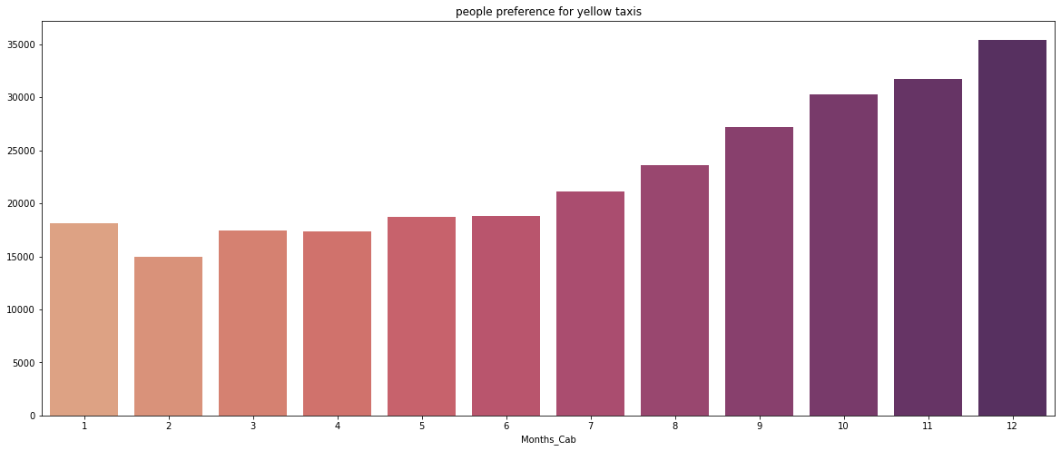
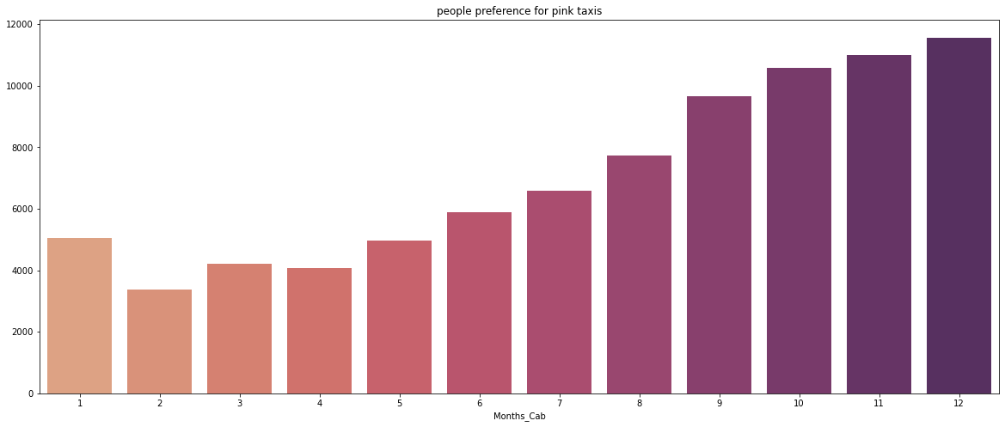
Human resources slide 4
Hypo 4: People prefer yellow or pink in any specific month
People refer yellow taxis for all the months over pink taxis & People tend to take more taxis in the month of December

Slide 12
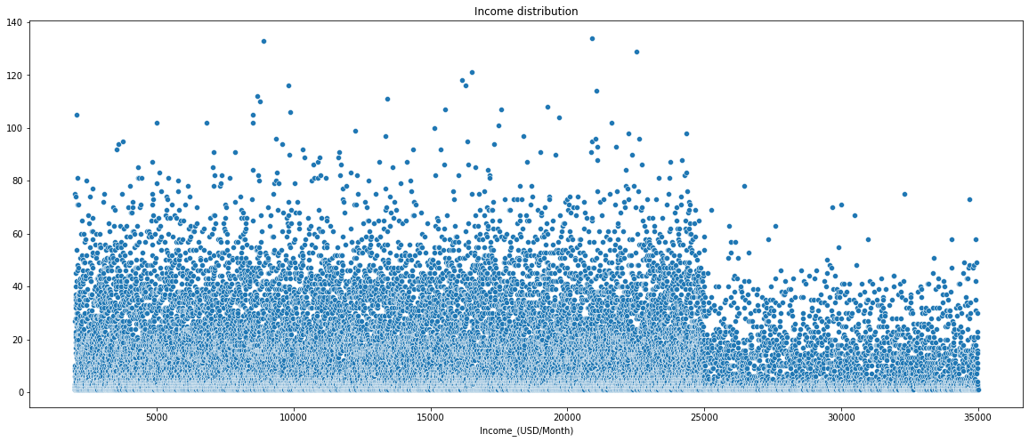
Human resources slide 4
Hypo 5: Income effect the number of rides
people with more income prefer less number of taxis, People with moderate income take more number of taxis contributing to the Profit

Slide 13
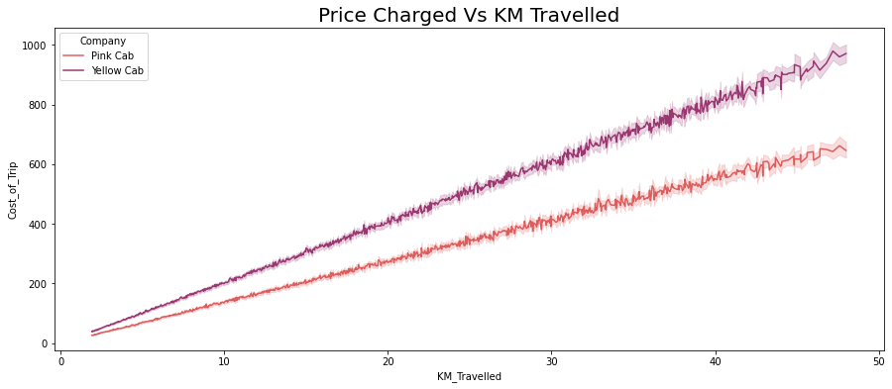
Human resources slide 4
Hypo 6: Price affects the choice of taxis
Yellow Taxis are more expensive than Pink Taxis, and people use yellow cabs more than pink , hence price don't effect the choice of taxis

Slide 14
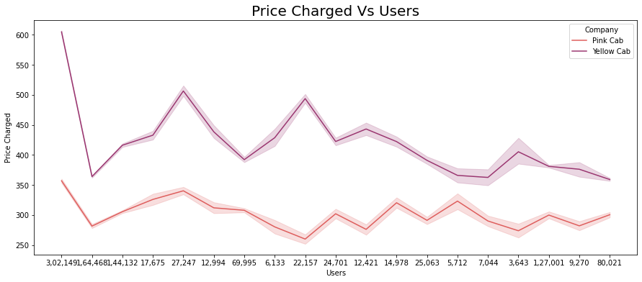
Human resources slide 4
Hypo 7: Price charged proportionally increase with increase in number of customers
Price Charged is not dependent on the number of users

Slide 15
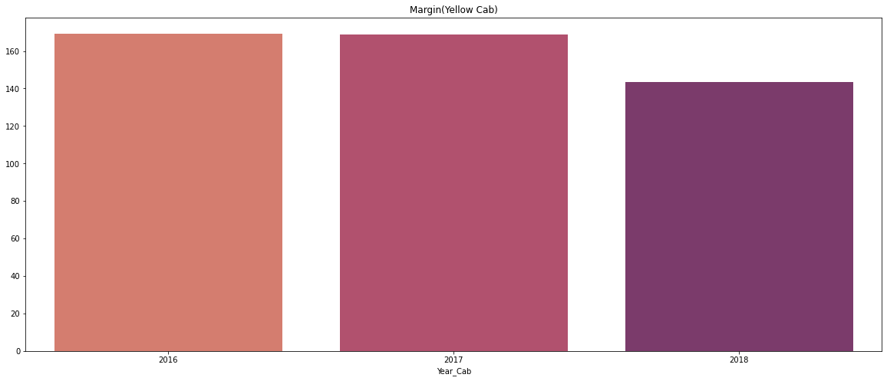
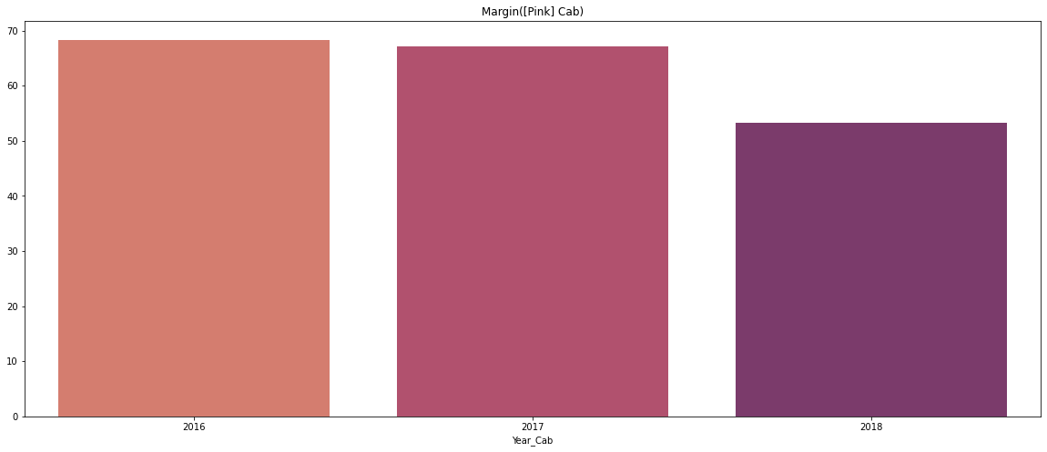
Human resources slide 4
Comparison of Yellow & Pink Cab
Total market profit share
Both the companies are facing losses in recent year, but the margin of yellow cab is more than pink cab

Slide 16
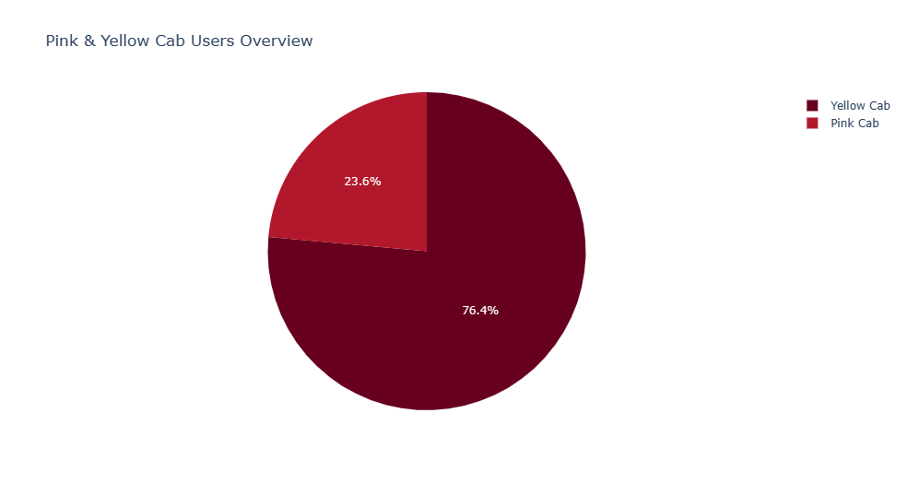
Human resources slide 4
Comparison of Yellow & Pink Cab
Total user share
Yellow Cabs have more Users than Pink Cab

Slide 17
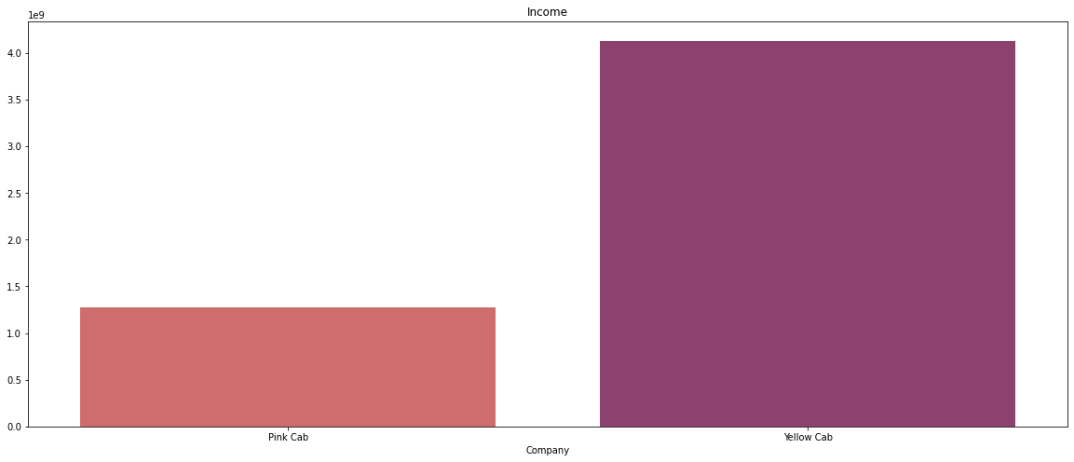
Human resources slide 4
Comparison of Yellow & Pink Cab
Yearly income
Yearly Income of Yellow Cabs are more than Pink Cabs

Slide 18
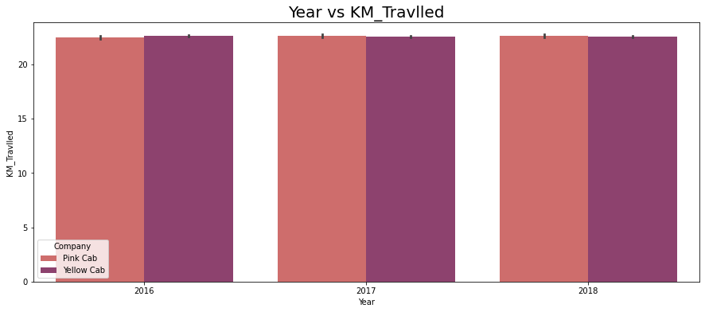
Human resources slide 4
Comparison of Yellow & Pink Cab
Number of kilometers
Total Number of Kilometres Travelled by Yellow Cabs Is almost same as Pink Cabs

Slide 19
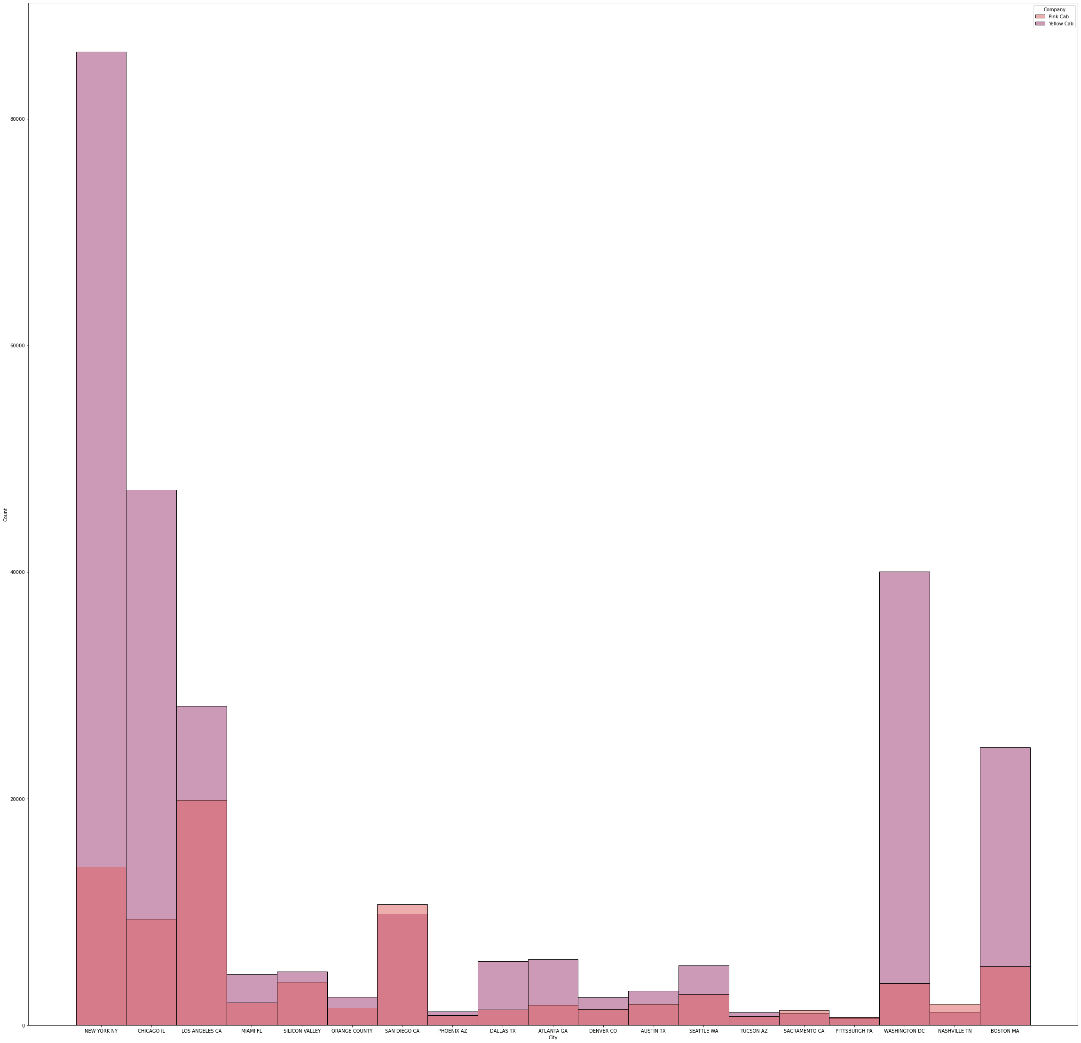
Human resources slide 4
Comparison of Yellow & Pink Cab
Which Cab is preferred in various City
Yellow Cab is Preferred by Most Cities over Pink Cabs

Slide 20
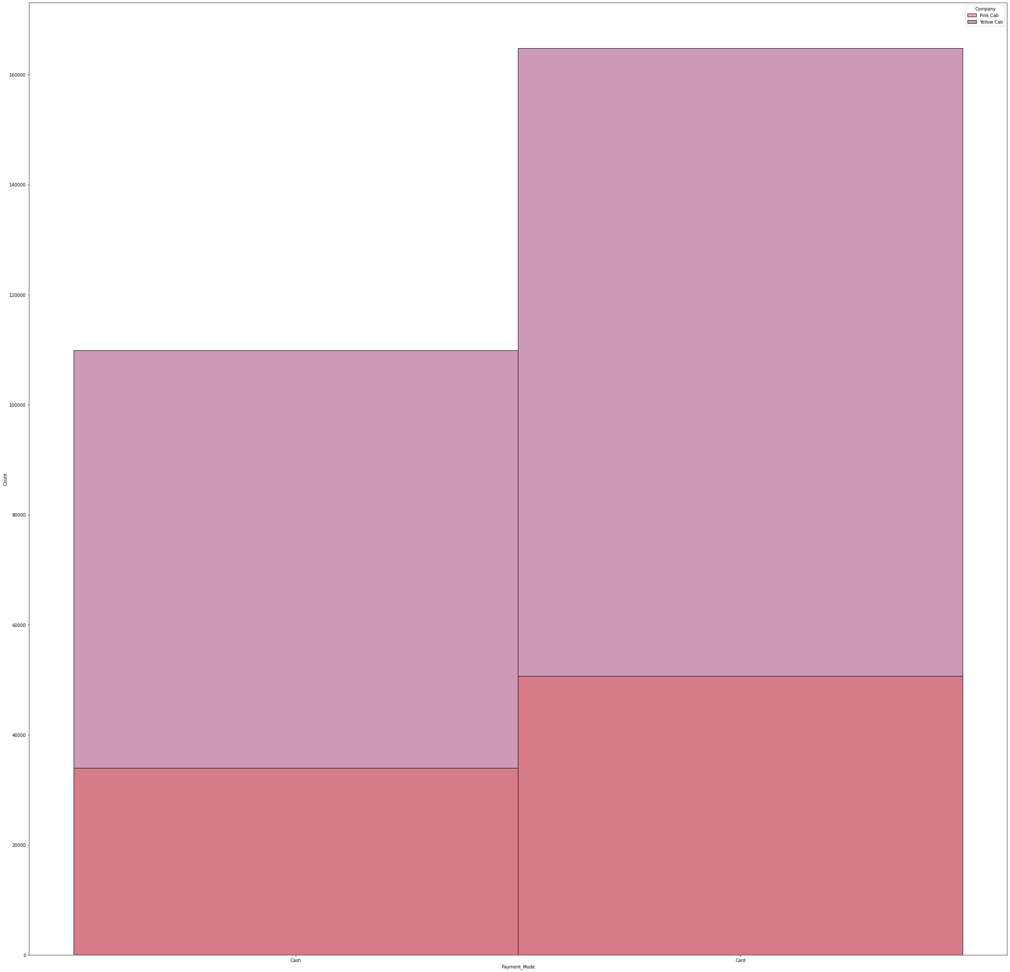
Human resources slide 4
Comparison of Yellow & Pink Cab
People tend to pay by card more than cash for both the company.

Slide 21
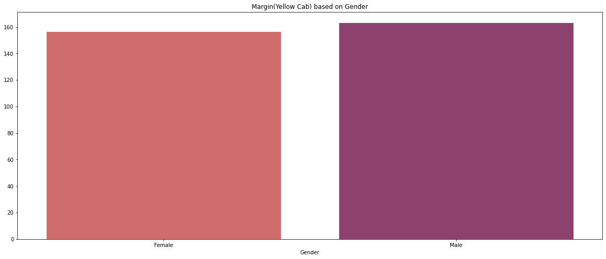
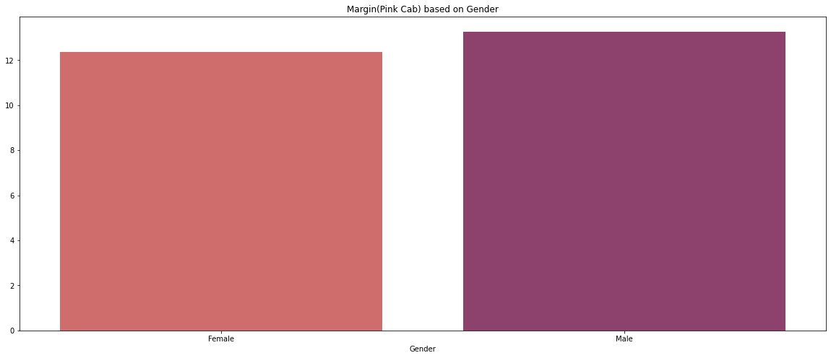
Human resources slide 4
Comparison of Yellow & Pink Cab
Does Profit of Company Depends on Gender
For both the Cab Company, Gender doesn’t affect the Profit

Slide 22
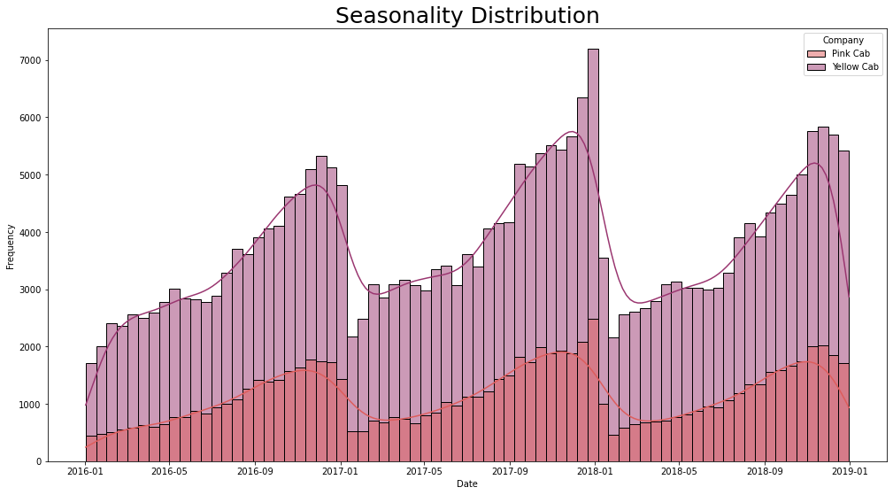
Human resources slide 4
Comparison of Yellow & Pink Cab
Is there any seasonality present
The Number of Trips for the month of Jan and dec are less as compared to other months

Slide 23






Key Takeaways
20XX
1
2
3
Yellow Cabs have more Users than Pink Cab
For both the Cab Company, Gender doesn’t affect the Profit
Both the companies are facing losses in recent year, but the margin of yellow cab is more than pink cab
4
5
6
There is no proof that females prefer pink taxis than yellow
People from New York city more cabs as compared to other cities
Price Charged is not dependent on the number of users

Slide 24

Human resources slide 8
Recommendations
The Yellow Cab Firm will be recommended for investment when we analyze both Cab Firms in terms of total market profit share, total user share, yearly income, and the number of kilometers travelled by users.

Slide 25
Human resources slide 10
Thank You

